Slide 1
The N-queens problem

Slide 2
introduction
In the game of chess, a queen can move as far as she pleases in any horizontal, vertical, or diagonal direction. The N-Queens Problem is the problem of placing N number of queens on a chessboard with N rows and N columns so no two queens hit each other in a single move. For no two queen to hit each other they cannot be placed on the same row, column, or diagonal and thus is a requirement for any solution.
The algorithms take n as input and compute the number of ways n queens can be placed on an n x n chessboard, while finding the best solution and recording the time taken to find the solutions.

Slide 3


Formal problem statement
Let X represent a chessboard of size N x N. Let $x_{i,j}$ represent a square on the board at the $i^{th}$ row and the $j^{th}$ column.
$$\sum_{\left(i, j\right)∈ squares}{x_{ij}=N}$$
Sets the number of queens to n and ensures all are placed on the chessboard.
Check that two queens are not on the same column.
Check that two queens are not on the same row.
Check if more than one queen is on the same diagonals in opposing directions.
Given sets $S_{1}$, $S_{2}$, … , $S_{n}$ of values X with $m_{1}$, $m_{2}$, … , $m_{n}$ values in the sets.
We are trying to find a solution vector X = ($x_{1}$, $x_{2}$, … , $x_{n}$) chosen from the sets out of $m_{1}$, $m_{2}$, … , $m_{n}$ possible candidates that will satisfy the constraints in a criterion function F(X).

Slide 4
Coding the solution

Slide 5
Notes:
The above figure shows the exact stack trace of how the backtracking program solves, for example, the 4 x 4 chessboard to get the 2 possible solutions. The numbers shown indicate the flow of control (helped us map the values in each square). Indicates when a function returns to a previous step, i.e. the algorithm backtracks. Here the function returns from 12 to 13. The algorithm backtracks from 2 to 3 to 4 as no further expansion of 2 gives any valid solutions, the algorithm backtracks.

Slide 6
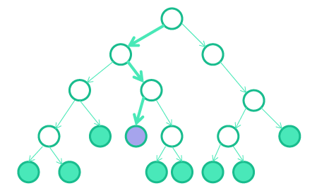
Branch and bound Algorithm

Slide 7
Branch and bound
The goal of a B&B algorithm is to find a value x that maximizes or minimizes the value of a real-valued function f(X), among some set S of valid, or possible solutions.
It recursively splits the search space into smaller spaces, i.e. branching, then minimizes f(X) on these smaller spaces.
To improve on the performance of backtracking, it keeps track of bounds on the minimum that it is trying to find, and uses these bounds to "prune" the search space, eliminating candidate solutions that it can prove will not contain an optimal solution.
O(n!)
Notes:
An enhancement of backtracking
For each node (partial solution) of a state-space tree, computes a bound on the value of the objective function for all descendants of the node (extensions of the partial solution)
Uses the bound for:
– ruling out certain nodes as “nonpromising” to prune the tree – if a node’s bound is not better than the best solution seen so far
– guiding the search through state-space

Slide 8
Branch and bound: Implementation
We chose to keep Boolean arrays that tell us which rows and which diagonals are occupied.
Pre-processing:
Create two N x N matrix one for / diagonal and other one for \ diagonal (slashCode and backslashCode). They are filled so that two queens sharing a same /­diagonal will have the same value in matrix slashCode, and if they share same \ ­diagonal, they will have the same value in backslashCode matrix.
For an N x N matrix, we fill slashCode and backslashCode matrix using:
slashCode[row][col] = row + col
backslashCode[row][col] = row – col + (N-1) >>> N – 1 used to ensure code is never negative because it must be used in array
Before queen i is placed on row j, we check whether row j is used (an array holds row data). Then we check whether slash code ( j + i ) or backslash code ( j – i + 7 ) are used (two arrays tell which diagonals are occupied). If yes, then we try a different location for queen i. If not, then we mark the row and the two diagonals as used and do a recursive call on queen i + 1. After the recursive call returns and before we try another position for queen i, we reset the row, slash code and backslash code as unused again.

Slide 9
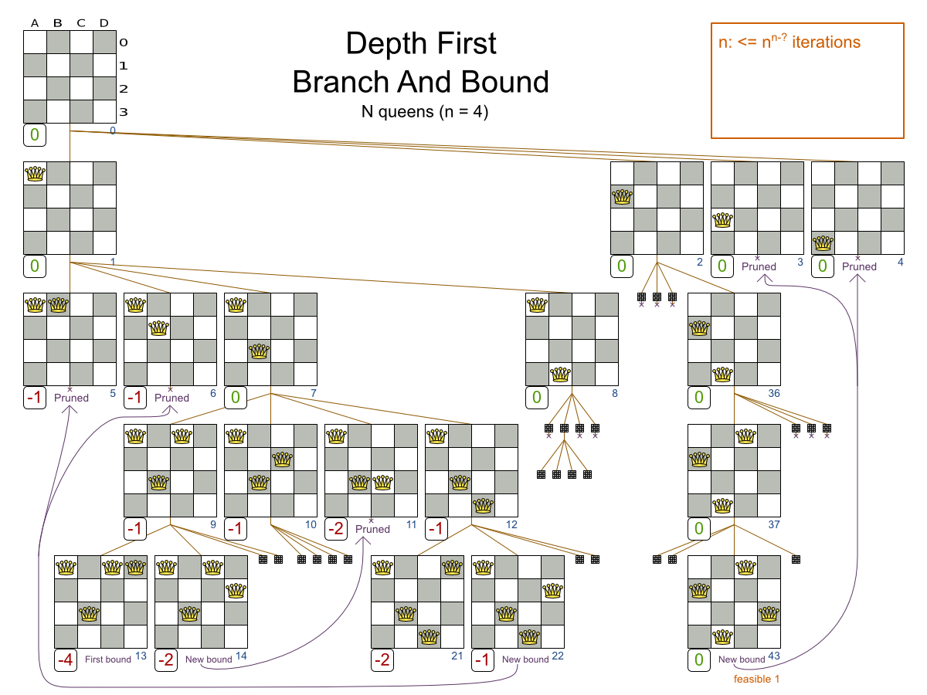

Slide 10
Python implementation of BB N-queen Solutions
if __name__ == "__main__":
N = int(input())
# Driver Code
solveNQueens()

Slide 11
Python implementation of BB N-queen Solutions
def solveNQueens():
board = [[0 for i in range(N)]
for j in range(N)]
board[0][0] = 1
slashCode = [[0 for i in range(N)]
for j in range(N)]
backslashCode = [[0 for i in range(N)]
for j in range(N)]
rowLookup = [False] * N
x = 2 * N - 1
slashCodeLookup = [False] * x
backslashCodeLookup = [False] * x
for rr in range(N):
for cc in range(N):
slashCode[rr][cc] = rr + cc
backslashCode[rr][cc] = rr - cc + N-1
if(solveNQueensUtil(board, 0, slashCode, backslashCode,
rowLookup, slashCodeLookup,
backslashCodeLookup) == False):
print("Solution does not exist")
return False
printSolution(board)
return True

Slide 12
Python implementation of BB N-queen Solutions
def solveNQueensUtil(board, col, slashCode, backslashCode,
rowLookup, slashCodeLookup,
backslashCodeLookup):
if(col >= N):
return True
for i in range(N):
if(isSafe(i, col, slashCode, backslashCode,
rowLookup, slashCodeLookup,
backslashCodeLookup)):
board[i][col] = 1
rowLookup[i] = True
slashCodeLookup[slashCode[i][col]] = True
backslashCodeLookup[backslashCode[i][col]] = True
if(solveNQueensUtil(board, col + 1, slashCode, backslashCode,
rowLookup, slashCodeLookup,
backslashCodeLookup)):
return True
board[i][col] = 0
rowLookup[i] = False
slashCodeLookup[slashCode[i][col]] = False
backslashCodeLookup[backslashCode[i][col]] = False
return False

Slide 13
Python implementation of BB N-queen Solutions
def printSolution(board):
for i in range(N):
for j in range(N):
print(board[i][j], end=" ")
print()
def isSafe(row, col, slashCode, backslashCode,
rowLookup, slashCodeLookup, backslashCodeLookup):
if (slashCodeLookup[slashCode[row][col]] or
backslashCodeLookup[backslashCode[row][col]] or
rowLookup[row]):
return False
return True

Slide 14
Introducing Parallel Program into N-QUEENS Problem
On each column we distribute the future computing on the other processes:
mapping for each column > row index > True if it_leads_to_solution else False
1
 | 1
1
 | 1
{(1,2):False}
{(0,0):False}
1
1
 | 1
1
 |  | 1
 | 1
1
 |  | 1
 | 1
{(2,1):False}

